Slide 1
Movie Recommender System -Team Whatflix-
ByungHyun Lee
JunYeong Ahn
JiHong Jeong

Slide 2


Goal
‘To develop unique movie recommendation system,
mainly based on similarity analysis’
& ‘XGBoost regression’

Slide 3
Today
Cold Start problem
Full data
Survey & Web crawling
Rating of the user
Data A for user
Data B for movie
Recommend ‘top 5’ movies
to the user
User-based CF
Movie-based CF
Comparison
Data
Feature creation
Cosine H.P
Pearson H.P
ML
Imputation
‘Rating’ regression using
XGBoost
Modeling

Slide 4
XGBoost
Hyper Parameter Tuning
Eta
Gamma
Max_depth
Min_child_weight

Slide 5
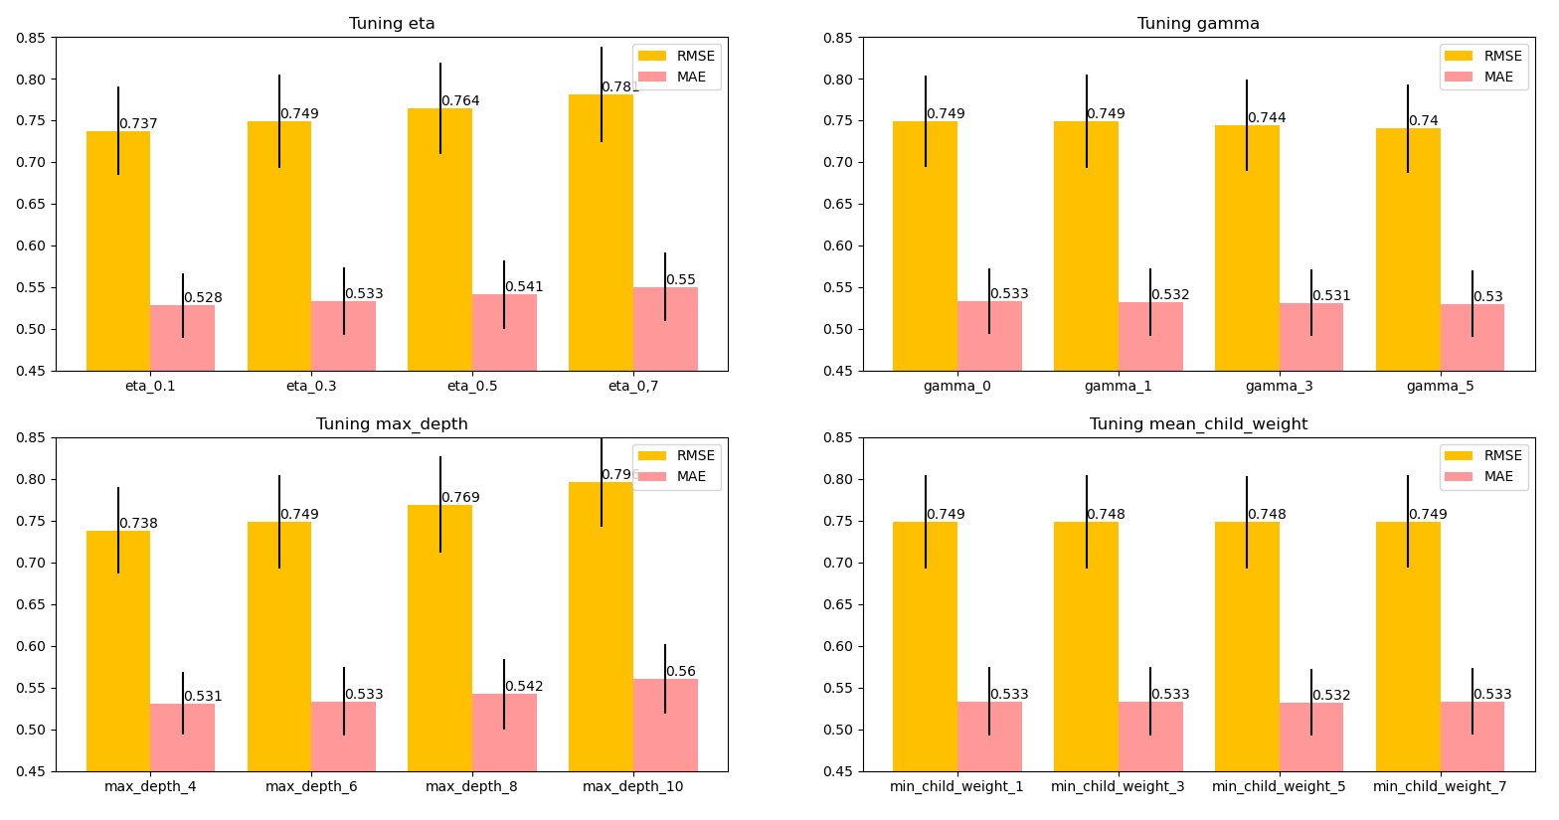
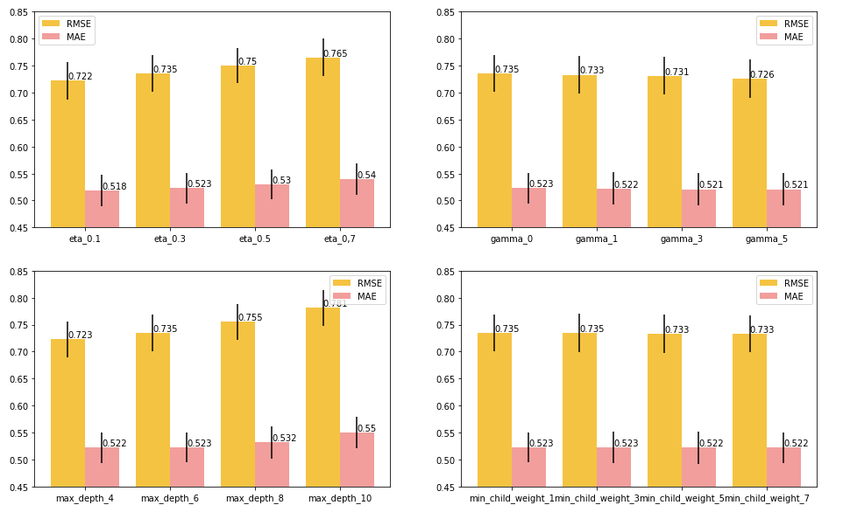
Hyper Parameter Tuning
Eta : Learning rate

Slide 6
Hyper Parameter Tuning
Gamma : Gamma is specified to minimize the loss reduction required for segmentation.

Slide 7
Hyper Parameter Tuning
Max_depth : The maximum depth of the tree.

Slide 8
Hyper Parameter Tuning
Min_child_weight : Defines the minimum sum of weights for all observations required in the child.

Slide 9
Hyper Parameter Tuning

Slide 10
Semi- Grid Search

Slide 11
Before
BEST!
Eta : 0.1 / 0.3 / 0.5 / 0.7
BEST!
Gamma : 0 / 1 / 3 / 5
BEST!
Max_depth : 4 / 6 / 8 / 10
BEST!
Min_child_weight : 1 / 3 / 5 / 7
,, BEST?

Slide 12
After
BEST!
Eta : 0.1 / 0.3 / 0.5 / 0.7
Gamma : 0 / 1 / 3 / 5
Max_depth : 4 / 6 / 8 / 10
Min_child_weight : 1 / 3 / 5 / 7
,,Grid Search!

Slide 13
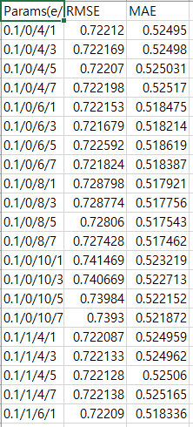
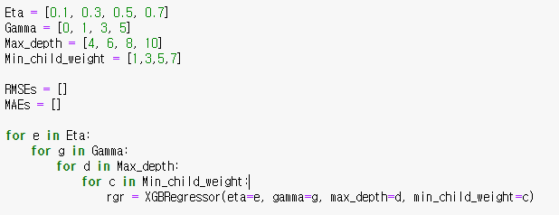

,,Semi’’
Grid Search automatically seeks the best parameters based on a single score :(

Slide 14
Result of Semi - Grid Search
Choosing the best parameter combination for each model
Cosine similarity
Pearson correlation coefficient
The top 5 lowest RMSE score
The top 5 lowest MAE score
Eta/gamma/max_depth/min_child_weight

Slide 15
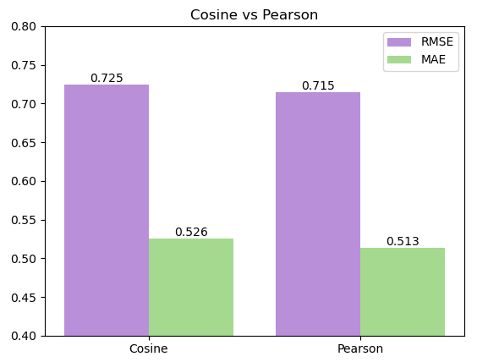
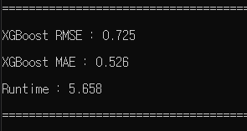
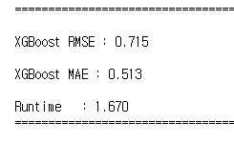
Train/Test (80/20)
Pearson correlation coefficient is better!

Slide 16
Final model
XGBRegressor(eta=0.1, gamma=5, max_depth=8, min_child_weight=7)

Slide 17
Final model
Create features
(Pearson correlation)
XGBRegressor(eta=0.1, gamma=5, max_depth=8, min_child_weight=7)
Predicted Ratings
Recommend Top 5
Rating & genre data
User’s rating
Cold start

Slide 18
Sincerely thank you for listening ☺

